Slide 1
The Dean of Students Office
Student Engagement & Enrollment Services

Slide 2
The Dean of Students office
Student Outreach & Support (SOS)
Off-Campus Student Life
Retention Outreach

Slide 3
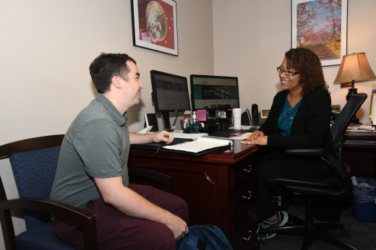
Student Outreach & Support
Listen to Student Concerns
Clarify University Policies
Refer to Appropriate Departments
Process Extended Absences & Administrative Withdrawals
Coordinate Care Outreach for Students
Oversee Emergency Financial Grants
Case Management

Slide 4
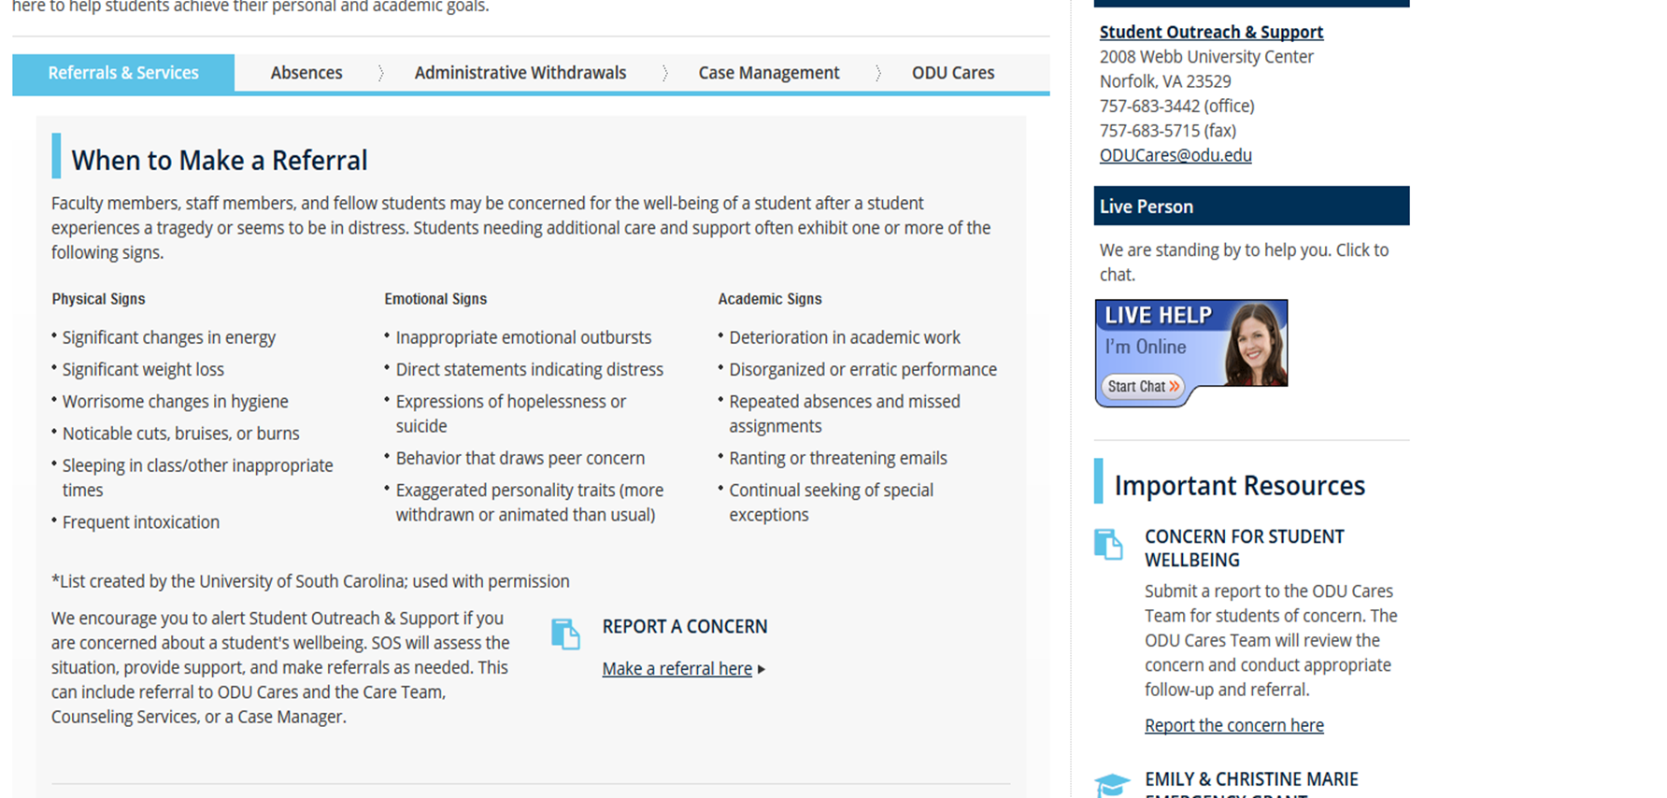
Reporting a Concern
www.odu.edu/sos

Slide 5
Other Ways to Refer
Bring in as Walk-in to 2008 Webb Center
Call 757-683-3442
Email oducares@odu.edu
Complete Care Report on the SOS website at odu.edu/sos

Slide 6
Off-Campus Student Life
Created to provide a centralized location for off-campus students to receive guidance, support, and resources for their off-campus experiences
Strive to work collaboratively with the neighborhoods surrounding Old Dominion University and the City of Norfolk on livability issues effecting students and long-term residents
Supports ODU students
Partnerships across campus and in the community
Resources offered:
Webpage with property listings
Workshops
Commuter lounge
Programs
Day locks at Webb Center
FREE security alarms and light bulbs
Food pantry

Slide 7
Key Partnerships
Campus Partnerships
Housing & Residence Life
Leadership & Student Involvement
ODUPD
Parking & Transportation
Student Conduct and Academic Integrity
Student Government Association
Community Partnerships
City of Norfolk Officials
Norfolk Cares
Rent Ready Norfolk
Norfolk Police Department

Slide 8
Off-Campus Housing Resources
Finding answers to questions about living off-campus as a first experience can be challenging
Off-Campus Student life helps students to stay knowledgeable of their responsibility of a local resident
The following website links are campus and community resources to off-campus students:
Local Property Listings
Roommate Search
Sample Off-Campus Roommate Agreement
Utility Set Up
Leasing Off-Campus
Move-in-move-out-checklist
Managing Your Finances

Slide 9
Retention Outreach
Oversees Retention Initiatives for 1st year Students
Assists with Departmental Referrals
Explores Options for Success at ODU

Slide 10
Connect with us!
The Off Campus Student Life Office is 1086 Webb Center
The Dean of Students Office is 2008 Webb Center (Above Panda Express!)
Dean of Students Office
oducares@odu.edu
(757) 683-3442
Off Campus Student Life:
offcampuslife@odu.edu
(757) 683-4187
Follow us on Instagram!
@odu_dos

