Slide 1
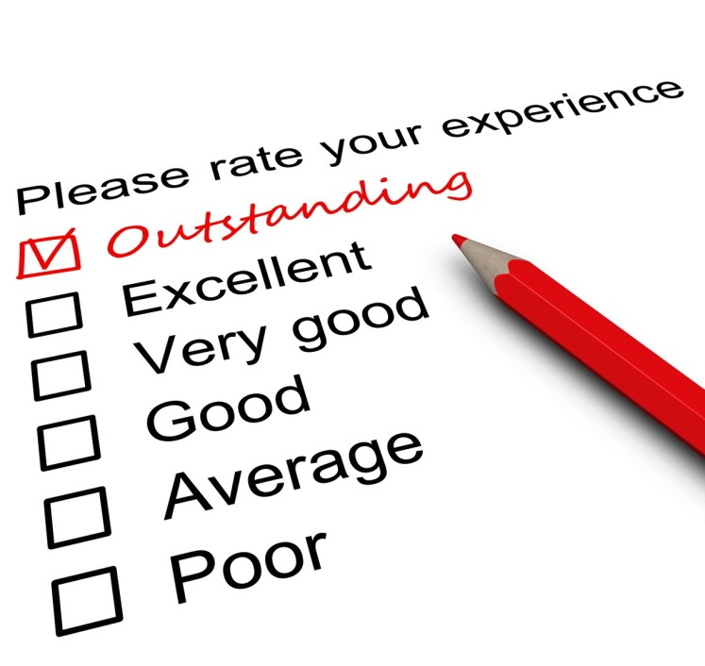
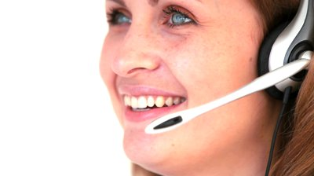
CUSTOMER SERVICE DONE RIGHT!

Slide 2
What’s the definition of customer service?
CUSTOMER SERVICE at ODU is now called Service Standards. It’s a certain standard that’s expected when you interact with others.
ODU has created a university-wide set of service standards that should be followed by every department on campus!
Notes:
EXPOUND ON CUSTOMER SERVICE BEING WHAT THAT PERSON RECEIVES AT THAT TIME. SEVERAL THINGS CAN LEAD TO CUSTOMER SERVICE

Slide 3
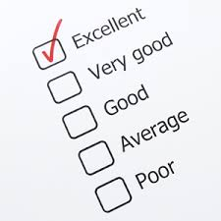
THE RULES OF GOOD CUSTOMER SERVICE!
REMEMBER, “YOU WILL BE JUDGED BY WHAT YOU DO, NOT WHAT YOU SAY”
BY SUSAN WARD, ABOUT.COM GUIDE
Answer the phone by the 3rd ring, with proper phone etiquette
Never let the customer walk away w/o some information (never say I don’t know, try to find out)
Deal with complaints, don’t try to pass them along!
Be knowledgeable-who knows your job better than you
Go that extra step to assist
Keep eye contact
Keep your promises

Slide 4
all of auxiliary units will at all times utilize The service standards:
Professional
Ethical
Respectful
Knowledgeable
Responsive
Collaborative

Slide 5
standards in detail…….
Professional We demonstrate professionalism by exhibiting a high level of competency and respect when interacting with students, colleagues and community members.
Ethical We adhere to the University’s Code of Ethics. We also demonstrate integrity to our students, colleagues and the community by adhering to University polices, procedures and standards of service.
Respectful-Everyone is to be treated with kindness, dignity and consideration.
Knowledgeable- We must be prepared to provide complete and accurate information to those requiring assistance.
Responsiveness We are committed to providing accurate, timely and solution-oriented services.
Collaborate work well with teammates to accomplish the ultimate goal of great customer service!

Slide 6
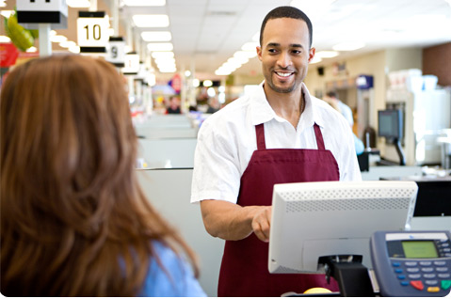
He looks friendly and eager to assist!!

Slide 7
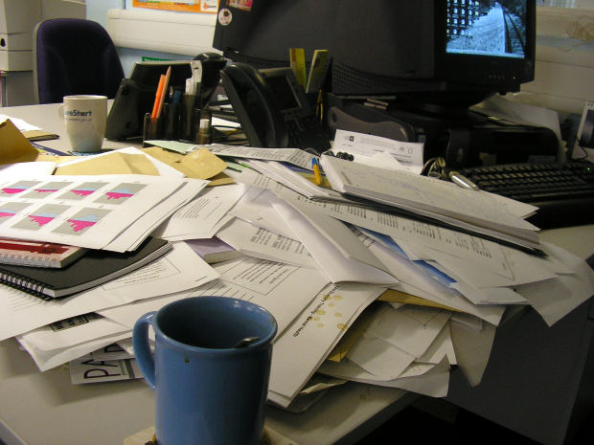
Organization is also VERY important WHEN DELIVERING GREAT CUSTOMER SERVICE!!!

Slide 8
A smile when talking over the phone is heard!

Slide 9
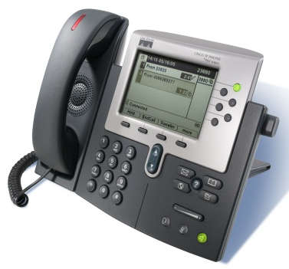
ODU’s Telephone protocol
Courtesy Response
Communicate in a courteous manner
Use a friendly tone of voice
Speak slowly and clearly so that the caller can understand you
Give the caller your full attention
Promptly answer phone
Answer calls promptly- 2nd or 3rd ring
Program voice mail to pick up in a timely manner- 3rd or 4th ring
Professional Greeting should include:
Good morning/afternoon
Your name/department name
Use a pleasant tone
Offer assistance
When answering for another department, always give that departments name
Offer Assistance
Help caller as much as you can before referring to someone else
Listen carefully/skillfully probe so you can adequately assess needs of the customer
Encourage caller to contact you again if additional assistance is needed

Slide 10
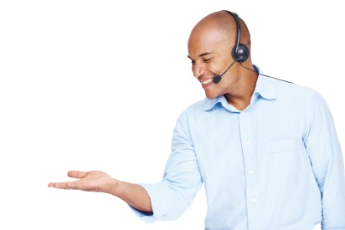
Telephone protocol Cont.
Connect Calls/No blind Transfers
If you must transfer a call, avoid the use of the word transfer.” Instead say, I’m going to connect you with…..”
Give the caller the person’s name and number prior to connecting the call
Stay on the line and introduce the caller to the connecting party (Do not connect the caller without an introduction and brief explanation of the call, i.e. “blind transfer.”)
If you reach the party’s voicemail when attempting to connect, ask the caller if they wish to be put through to the voice mail
(do not automatically connect to voice mail w/o asking caller first)
Offer Assistance
Help caller as much as you can before referring to someone else
Listen carefully/skillfully probe so you can adequately assess needs of the customer
Encourage call to contact you again if additional assistance is needed
Hold Appropriately
Do not automatically place a caller on hold. Let the caller know that you are doing so
Provide periodic updates to see if the caller still wishes to hold
Never place a caller on hold by just laying the phone down, always use the hold button

Slide 11
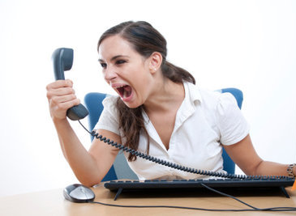
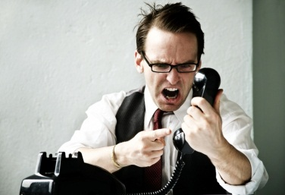
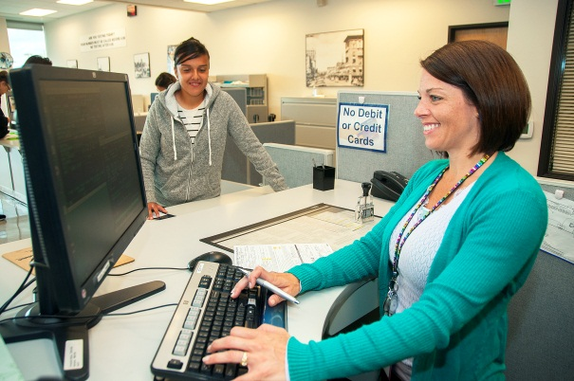
EXAMPLES OF POOR CUSTOMER SERVICE
Raising your voice when customers are upset.
keeping a caller on hold longer than 45 seconds, If you must keep a caller on hold longer than 45 seconds, make sure the caller is aware that they will be on hold for an extended length of time.
Not acknowledging them as soon as they approach the desk or office.
Telling a customer “I don’t know.” Find out!
Don’t leave the front desk area unattended. Someone should be there at all times (during hours of operation ☺)

Slide 12
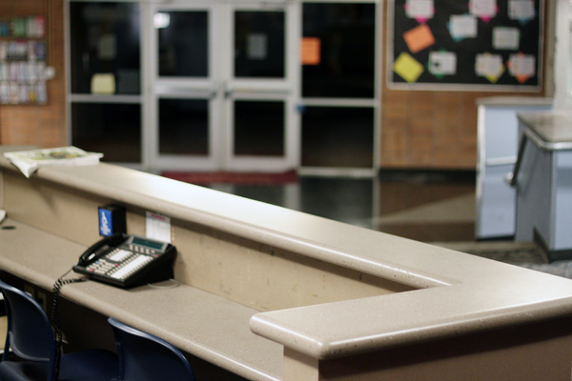
HEY!! WHERE’S EVERYONE??????

Slide 13
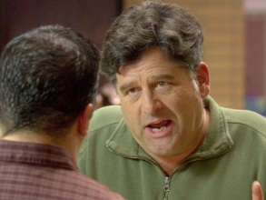
RESOLVING COMPLAINTS I
A process to resolve complaints helps assure that we can deal with the emotional/practical aspects of the issue follow the following 8 steps
Greet: Greet people on the phone/in person as if you are happy to hear from them.
Listen: Give the customer an opportunity to vent some of their frustration. Be empathetic, and listen for facts and feelings. Don’t respond too quickly, and show signs of active listening.
Questions: We want to avoid responding too quickly, so ask questions to clarify the concern.
Empathize: Find an agreement point, not saying that we agree, but that we understand their complaint and we hear their concern and that it is important.

Slide 14
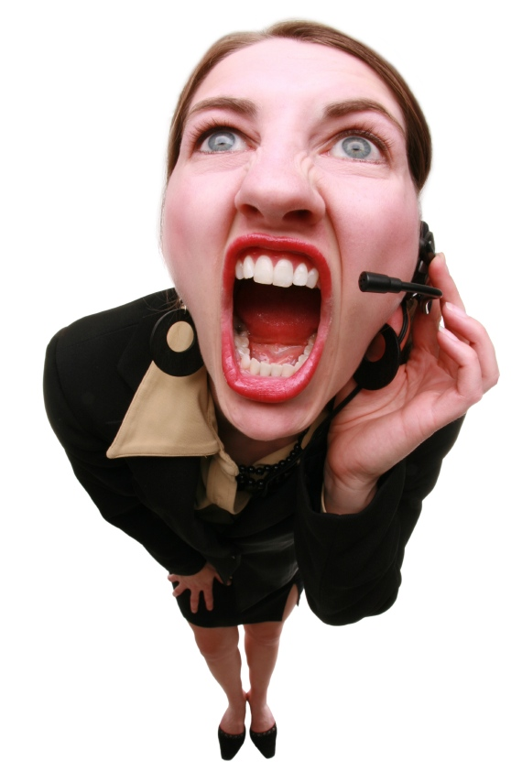
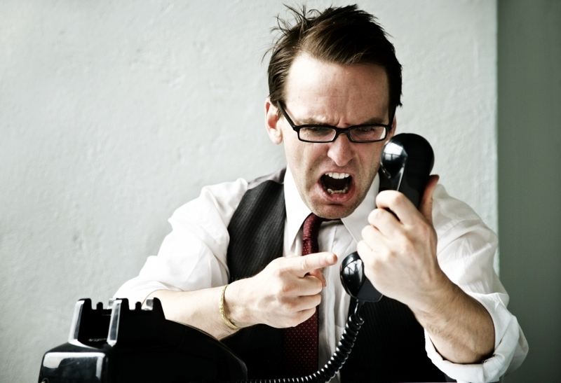
A BIG NO NO!!!

Slide 15
RESOLVING COMPLAINTS II
Address the issue: Now it’s time to resolve the practical aspects of the complaint. Take responsibility for the actions of your organization. If you can resolve the issue successfully, then most likely that person will continue to do business w/your company.
Test Questions: Ask questions to test how well you have resolved the emotional and practical sides of the complaint, giving the customer another opportunity to talk, remember to be a good listener!
Offer additional help: Ask if there’s anything else you can do for them, giving an opportunity to turn the conversation away from the complaint to end on a positive note.
Follow Through: Sometimes a resolution isn’t reached immediately, meaning you will have to get back to the customer, so do it quickly and thoroughly.

Slide 16
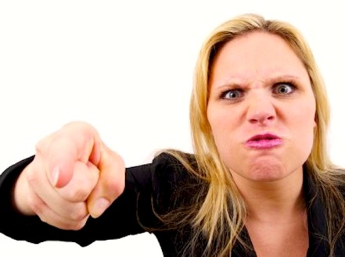
DEALING With IRATE CUSTOMERS
Stay calm. Be diplomatic and polite. Getting angry only makes the customer angrier.
Try to see things from the callers point of view. Thank the person for raising the concern and do it sincerely, emphasize the importance of satisfied customers to you and your organization.
Listen for understanding. Sometimes the irate customer just wants someone to listen to their story.
Make sure to ask questions to get their facts and feelings.
Establish common ground to show the person you are listening.
Always show a willingness to resolve the problem or conflict. Make the resolution seem as easy as possible.
Respond as an understanding friend rather than citing policies, be genuine and show your personality.
Be firm, but understanding with your answers.

