Slide 1
Old Dominion University Student Health Services Graduate & International Student Orientation Fall 2021

Slide 2
Holistic Health and Wellness
This Photo by Unknown Author is licensed under CC BY

Slide 3
ODU Student Health Services
Location:
1007 South Webb Center
Norfolk, VA. 23529
Telephone: 757-683-3132 – CALL AHEAD for AN APPOINTMENT
Email: studenthealth@odu.edu
Hours:
Fall 2021 Hours: Monday thru Friday
8 a.m. to 7 p.m.

Slide 4
Who is Eligible for Our Services?
Full-Time Graduate Students
Part-Time students pay a service fee during clinic visits
Student Health Services DOES NOT require health insurance to be seen; the United Healthcare Plan is available to students through the office of Graduate Studies; https://www.odu.edu/graduateschool/graduate-student-health-insurance

Slide 5
Fees
Full time graduate students are charged the $110.00 per semester health fee
Part-time graduate students are charged upon seeking services
Late or re-schedule fee is $10.00
Fees are charged for physicals, immunizations, labs, and some medical supplies
Student Health Services does NOT require insurance

Slide 6
Services Provided
Primary Care
Acute Care
Telehealth/Telemedicine
Immunizations (COVID-19 Vaccine Available (Limited)
Sexually Transmitted Disease Testing
Family Planning (Contraception)
Women’s Health
Laboratory Services

Slide 7
How to Schedule An Appointment
Walk-In or Same Day Appointments
Self-Schedule
Call Student Health Services
Schedule via the Monarch Wellness Portal at MyOdu | Main view
Please memorize your MIDAS ID & University Identification Number (UIN)

Slide 8
Health Care Providers
Physicians
Nurse Practitioners
Physician Assistants
Registered Nurses
Licensed Practical Nurses
Medical Assistants
Medical Laboratory Technicians
Patient Care Specialists

Slide 9
ODU Health Entrance Requirements
The Student Health Center is required by the Commonwealth of Virginia Law 23.1-800 to require the following upon admission (Undergraduate and Graduate students)
1.) Completed Health History
2.) Current Immunizations Diphtheria, Tetanus, Poliomyelitis, Measles (Rubeola), German Measles (Rubella), Mumps, Meningococcal, Hepatitis B
(per the American College Health Association)
3.) Tuberculosis Screening
4.) COVID-19 Vaccine
Due Date: August 1st
DUE DATE: August 1st
This Photo by Unknown Author is licensed under CC BY

Slide 10
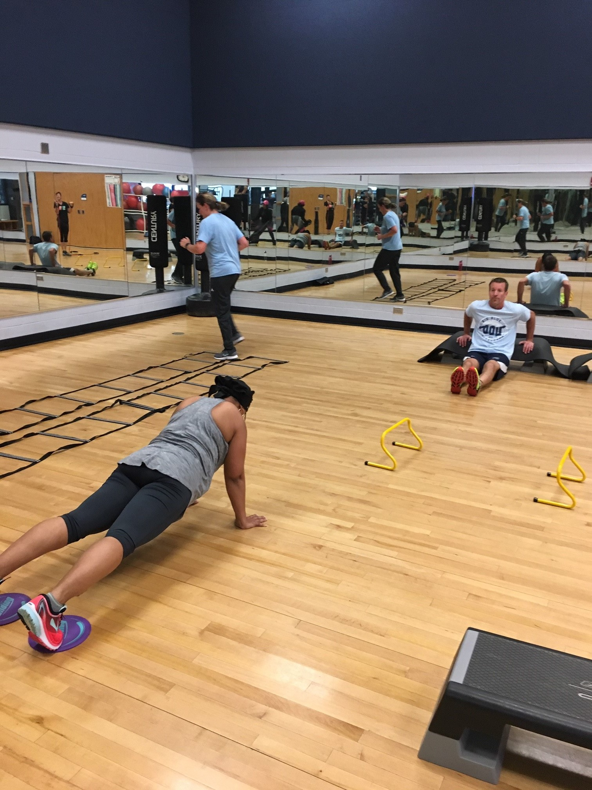
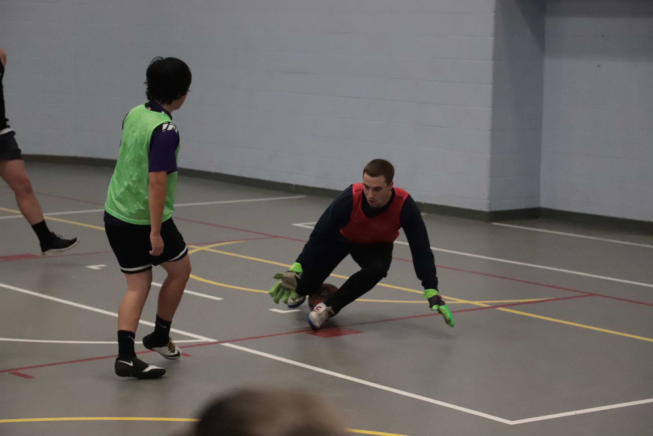
Wellness Services
Health Promotion
Women’s Center
Recreation and Wellness
Registered Dietician

Slide 11
Monarch Wellness Portal
ODU Monarch Wellness Portal
Access to review secure records
COVID-19 Daily Check-In
View and Print Immunization Records
Health Education Sites
Update contact address and phone number
Schedule appointments online (telehealth currently)

Slide 12
How to Schedule An Appointment
Walk-In or Same Day Appointments
Self-Schedule
Call Student Health Services
Schedule via the Monarch Wellness Portal at MyOdu | Main view
Please memorize your University Identification Number (UIN)

Slide 13
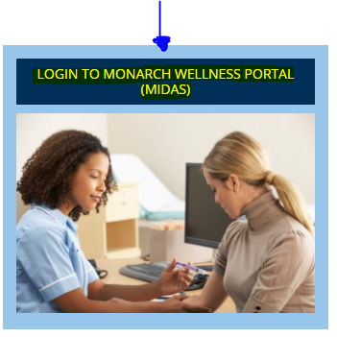
How to Schedule An Appointment
Walk-In or Same Day Appointments
Self-Schedule
Call Student Health Services
Schedule via the Monarch Wellness Portal at MyOdu | Main view
Please memorize your University Identification Number (UIN)

Slide 14
How to Protect Yourself from COVID-19
Get vaccinated with the COVID-19 vaccine
Wash your hands often with soap and water for 20 seconds; if soap is unavailable use hand sanitizer
Avoid direct contact with people outside of your household (6ft distance from other people)
Cover your mouth and nose with a cloth face cover when around others
Cover coughs and sneezes
Clean and disinfect frequently touched surfaces daily (cell phone, computer, desk, doorknobs)
Monitor your health and if you feel sick stay in your residence hall; do not go to class.
This Photo by Unknown Author is licensed under CC BY-ND

Slide 15
International Student Travel Information

